Slide 1
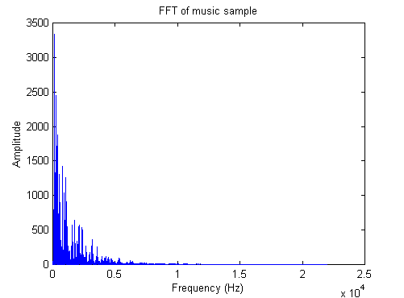
Signal Processing with the Fast Fourier Transform

Slide 2

Discrete Fourier Transform(DFT)
In mathematics, the discrete Fourier transform (DFT) converts a finite list of equally spaced samples of a function into the list of coefficients of a finite combination of complex sinusoids, ordered by their frequencies, that has those same sample values. It can be said to convert the sampled function from its original domain (often time or position along a line) to the frequency domain.

Slide 3

The Problem…
Its too slow to be practical.

Slide 4
Fast Fourier Transform (FFT)
Gauss(1805) – unpublished work
Cooley and Tukey(1965) –published
An FFT computes the DFT and produces exactly the same result as evaluating the DFT definition directly; the most important difference is that an FFT is much faster.
Evaluating this definition directly requires O(N²) operations: there are N outputs X_{k}, and each output requires a sum of N terms. An FFT is any method to compute the same results in O(N log₂ N) operations.

Slide 5
FFT vs. DFT Why the FFT is Important
N | 1000 | 10⁶ | 10⁹
O(N²) | 10⁶ | 10¹² | 10¹⁸
O(N log₂ N) | 10⁴ | 20x10⁶ | 30x10⁹
If we measure these values in nanoseconds:
10¹⁸ ns = 31.2 years
30x10⁹ ns = 30 seconds

Slide 6
FFT Algorithm Examples
Cooley-Tukey algorithm:
By far the most commonly used FFT is the Cooley–Tukey algorithm. This is a divide and conquer algorithm that recursively breaks down a DFT of any composite size N = N₁N₂ into many smaller DFTs of sizes N₁ and N₂, along with O(N) multiplications by complex roots of unity traditionally called twiddle factors.
Prime-factor FFT algorithm
The prime-factor algorithm (PFA), also called the Good–Thomas algorithm (1958/1963), is a fast Fourier transform (FFT) algorithm that re-expresses the discrete Fourier transform (DFT) of a size N = N₁N₂ as a two-dimensional N₁×N₂ DFT, but only for the case where N₁ and N₂ are relatively prime. These smaller transforms of size N₁ and N₂ can then be evaluated by applying PFA recursively or by using some other FFT algorithm.

